Slide 1
Fibonacci anyon with topological “charge” 1
Fusion rules: 1x1 = 0+1; 1x0 = 0x1 = 1; 0x0 = 0
F Matrix:
Pentagon
F
F
F
F
F

Slide 2
The R Matrix
a
a

Slide 3
The R Matrix
R
a
a

Slide 4
R
F
F
R
R
F

Slide 5
The Hexagon Equation
R
F
F
R
R
F

Slide 6
The Hexagon Equation
0
0
1
1

Slide 7
The Hexagon Equation
0
0
1
1

Slide 8
The Hexagon Equation
1
0
0
1
1

Slide 9
The Hexagon Equation
a
1
0
0
1
1

Slide 10
The Hexagon Equation
F_{0a}
a
1
0
0
1
1

Slide 11
The Hexagon Equation
F_{0a}
a
1
0
0
1
1

Slide 12
The Hexagon Equation
F_{0a}
a
1
a
1
0
0
1
1

Slide 13
The Hexagon Equation
δ_{a,0} + R₁ δ_{a,1}
F_{0a}
a
1
a
1
0
0
1
1

Slide 14
The Hexagon Equation
δ_{a,0} + R₁ δ_{a,1}
F_{0a}
a
1
a
1
0
0
1
1

Slide 15
The Hexagon Equation
δ_{a,0} + R₁ δ_{a,1}
F_{0a}
a
1
a
F_{a0}
1
0
0
1
1

Slide 16
The Hexagon Equation
δ_{a,0} + R₁ δ_{a,1}
F_{0a}
a
1
a
F_{a0}
1
0
0
1
1
0
1

Slide 17
The Hexagon Equation
δ_{a,0} + R₁ δ_{a,1}
F_{0a}
a
1
a
F_{a0}
1
0
0
1
1
R₀
0
1

Slide 18
The Hexagon Equation
δ_{a,0} + R₁ δ_{a,1}
F_{0a}
a
1
a
F_{a0}
1
0
0
1
1
R₀
0
1

Slide 19
The Hexagon Equation
δ_{a,0} + R₁ δ_{a,1}
F_{0a}
a
1
a
F_{a0}
1
0
0
1
1
R₀
0
1
1

Slide 20
The Hexagon Equation
δ_{a,0} + R₁ δ_{a,1}
F_{0a}
a
1
a
F_{a0}
1
0
0
1
1
R₀
0
1
0
1

Slide 21
The Hexagon Equation
δ_{a,0} + R₁ δ_{a,1}
F_{0a}
a
1
a
F_{a0}
1
0
0
1
1
R₀
0
1
0
1
F₀₀

Slide 22
The Hexagon Equation
δ_{a,0} + R₁ δ_{a,1}
F_{0a}
a
1
a
F_{a0}
1
0
0
1
1
R₀
0
1
0
1
F₀₀

Slide 23
The Hexagon Equation
δ_{a,0} + R₁ δ_{a,1}
F_{0a}
a
1
a
F_{a0}
1
0
0
1
1
R₀
R₀
0
1
0
1
F₀₀

Slide 24
The Hexagon Equation
δ_{a,0} + R₁ δ_{a,1}
F_{0a}
a
1
a
F_{a0}
1
0
0
1
1
R₀
R₀
0
1
0
1
F₀₀
Top path
Bottom
path

Slide 25
The Hexagon Equation
R
F
F
R
R
F
Only two solutions:

Slide 26
Basic Content of an Anyon Theory
“Charge” values: 0, 1
Fusion rules: 1x1 = 0+1; 1x0 = 0x1 = 1; 0x0 = 0
F Matrix:
R Matrix:
Pentagon
Hexagon
R
F
F
F
F
F
F
R
R
F
F

Slide 27
Qubit Encoding
Qubit States
Non-Computational State
0
1
1
0
1
1
State of qubit is determined by “charge” of two leftmost particles
Transitions to this state are
leakage errors
Notes:
27

Slide 28
Elementary Braid Matrices
time
a
1
Notes:
28

Slide 29
Elementary Braid Matrices
time
a = 0 1
a
1
Notes:
29

Slide 30
Elementary Braid Matrices
time
a
1
a
1
Notes:
30

Slide 31
Elementary Braid Matrices
time
a
1
a
1
Notes:
31

Slide 32
Elementary Braid Matrices
a
1
a
1
Ψ
Ψ
=
M ^{T}
Ψ
i
f
i
1
1
σ₁⁻¹ σ₂ σ₁⁻¹ σ₂ = M
Notes:
32

Slide 33
A Quantum Bit: A Continuum of States
θ
φ
θ
θ
ψ
=
cos
0
+
sin
e
−
i
φ
1
2
2
Notes:
33

Slide 34
Single Qubit Operations: Rotations
α = rotation vector
Direction of α is the rotation axis
Magnitude of α is the rotation angle
α
θ
θ
ψ
=
cos
0
+
sin
e
−
i
φ
1
2
2
Notes:
34

Slide 35
Single Qubit Operations: Rotations
α = rotation vector
α
ψ
U
r
U
r
ψ
α
α
Notes:
35

Slide 36
Single Qubit Operations: Rotations
2 π
The set of all single qubit rotations lives in a solid sphere of radius 2π.
α
−2 π
2 π
Qubits are sensitive:
Easy to make errors!
ψ
U
r
U
r
ψ
−2 π
α
α
Notes:
36

Slide 37
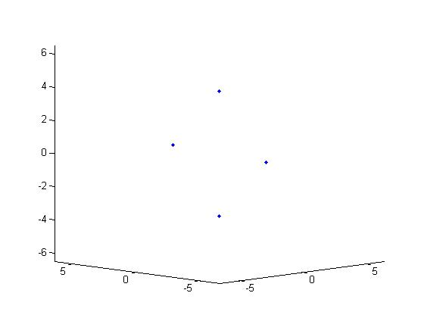
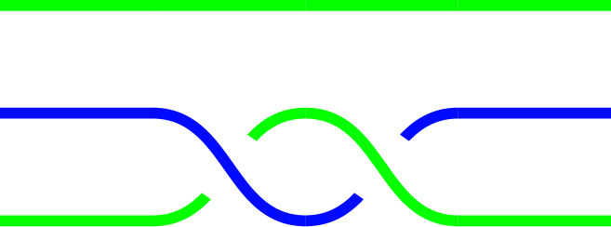
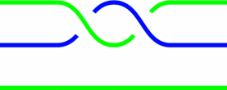
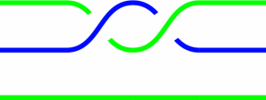
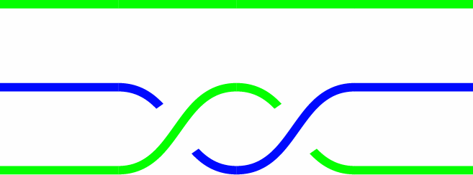
σ₁²
2 π
σ₂²
−2 π
−2 π
2 π
σ₂⁻²
−2 π
σ₁⁻²

Slide 38
N = 1

Slide 39
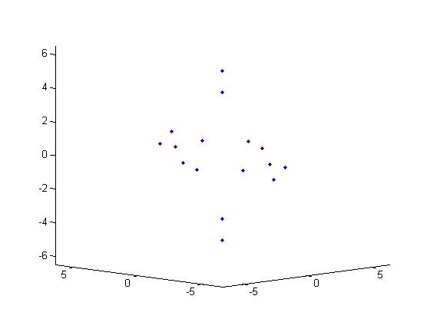
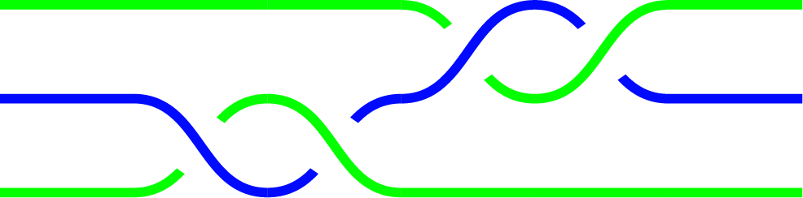
N = 2

Slide 40
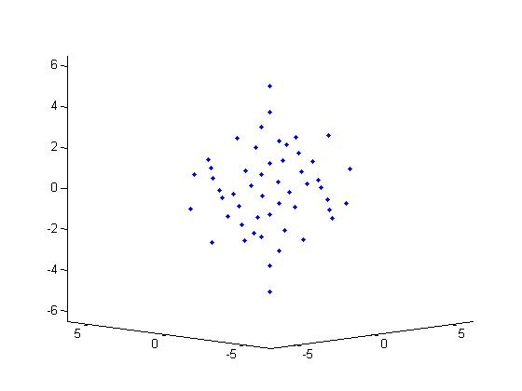
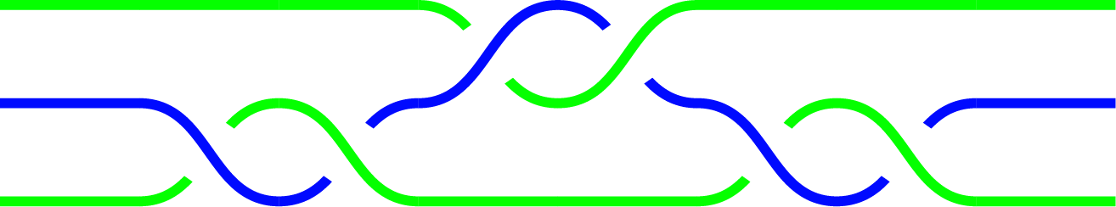
N = 3

Slide 41
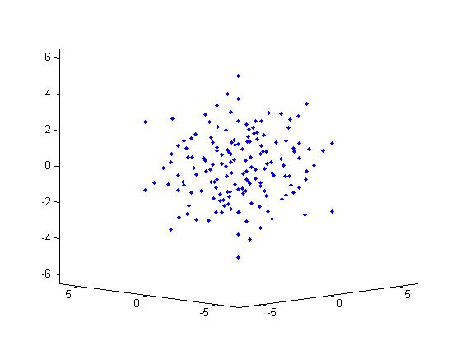
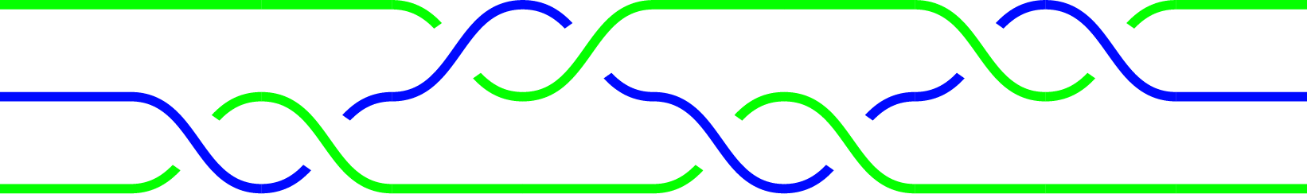
N = 4

Slide 42
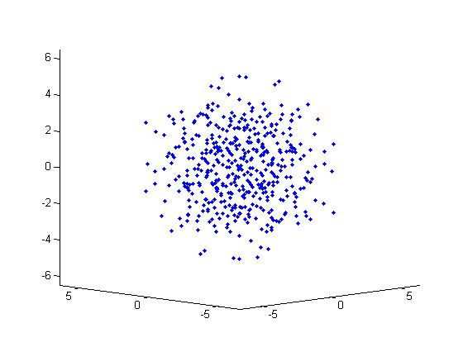
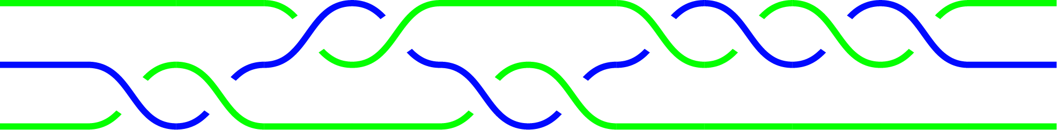
N = 5

Slide 43
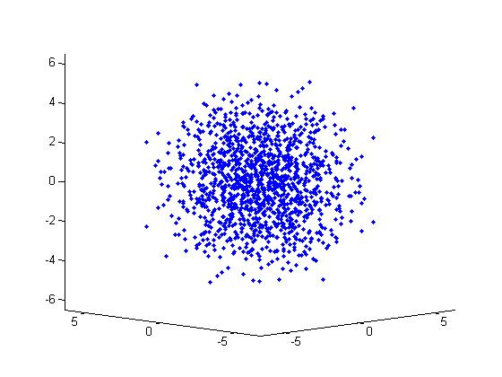
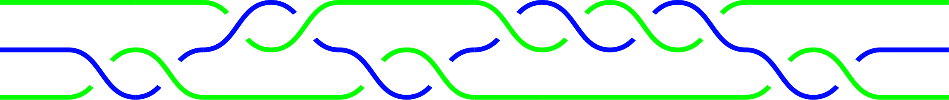
N = 6

Slide 44
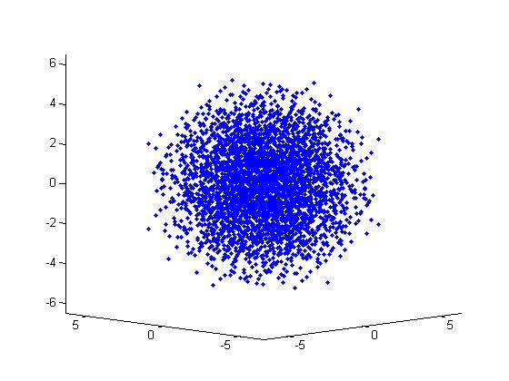
N = 7

Slide 45
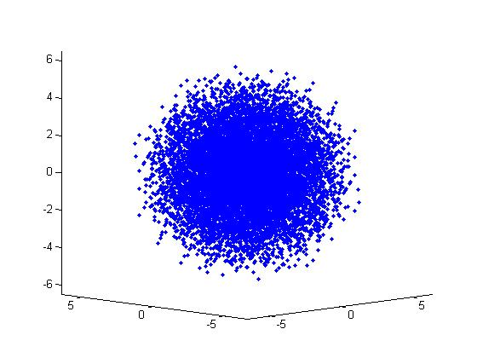
N = 8

Slide 46
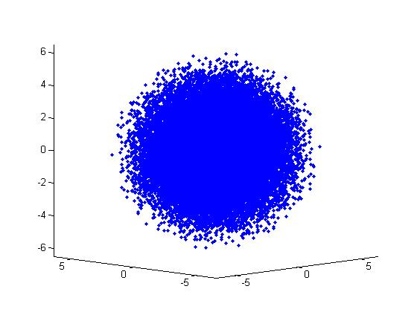
N = 9

Slide 47
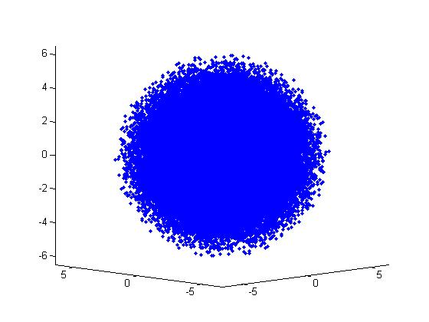
N = 10

Slide 48
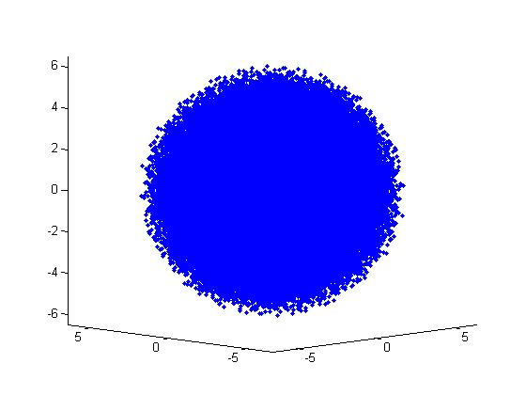

N = 11

Slide 49
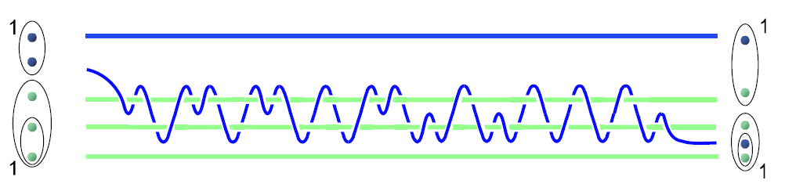
Brute Force Search
Notes:
49

Slide 50
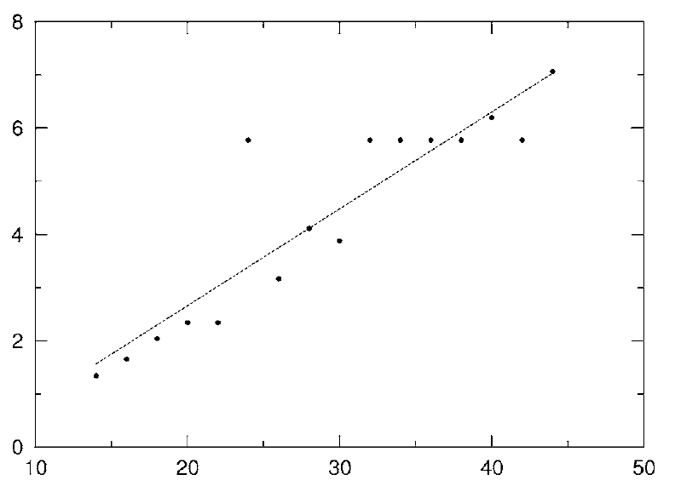
Brute Force Search
ε
“error”
For brute force search:
|ln
ε |
Braid Length
Braid Length
L. Hormozi, G. Zikos, NEB, S.H. Simon, PRB ‘07
Notes:
50

Slide 51
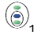
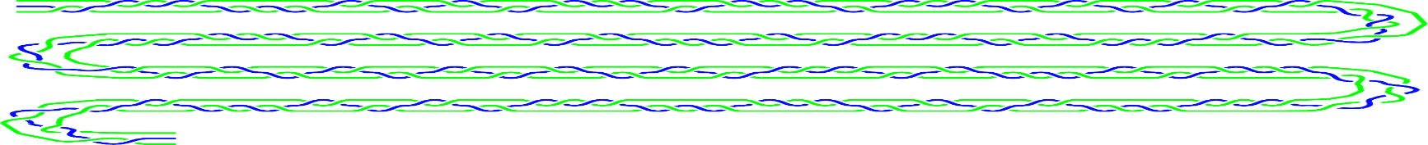
Beyond Brute Force Search
Given a sufficiently dense covering of SU(2), braids can be systematically improved by Solovay-Kitaev (see, e.g., Dawson and Nielson, RMP 2002).
Braid Length
,
Recent Development
Using ideas from algebraic number theory can asymptotically achieve:
Braid Length
Notes:
51

Slide 52
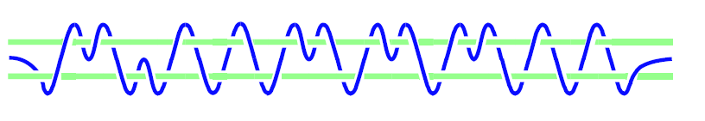
Single Qubit Operations
U
time

Slide 53
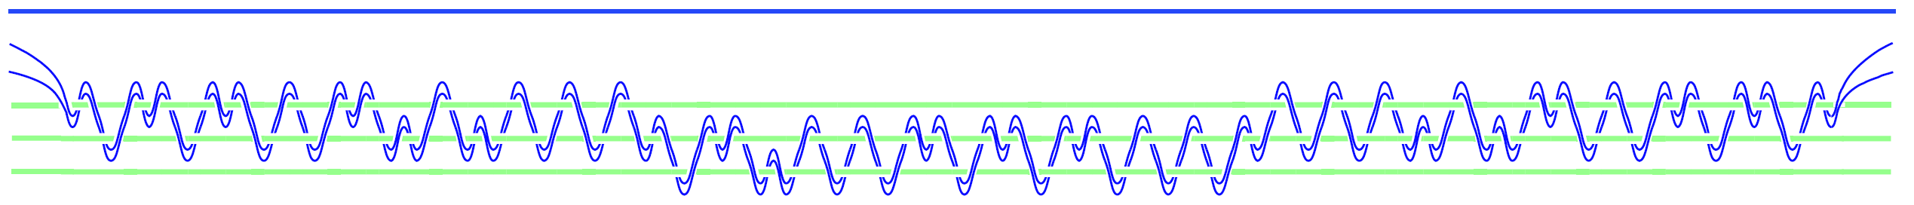
Two Qubit Gates (CNOT)
X
NEB, L. Hormozi, G. Zikos, & S. Simon, PRL 2005
L. Hormozi, G. Zikos, NEB, and S. H. Simon, PRB 2007

Slide 54
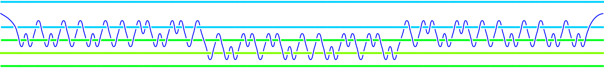
Other Two-Qubit Gates
L. Hormozi, G. Zikos, NEB, and S.H. Simon, PRB ‘07.
Xu and Wan, PRA ‘08.
C.Carnahan, D. Zeuch, and NEB, arXiv:1511.00719.
Notes:
54

Slide 55
Quantum Circuit
X
U
X
X
U
X

Slide 56
Quantum Circuit
X
U
X
X
U
X

Slide 57
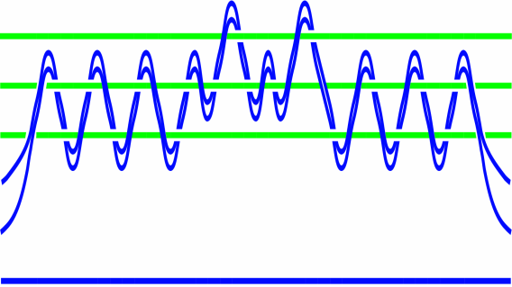

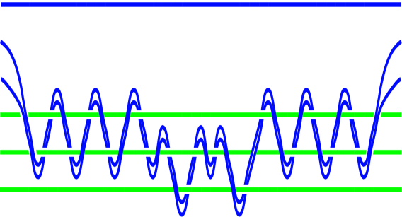






Braid

Slide 58
SU(2)_{k} Nonabelian Particles
Quasiparticle excitations of the ν=12/5 state (if it is a Read-Rezayi state) are described (up to abelian phases) by SU(2)₃ Chern-Simons theory.
In fact, Read and Rezayi proposed an infinite sequence of nonabelian states labeled by an index k with quasiparticle excitations described by SU(2)_{k} Chern-Simons theory.
Read and Rezyai, 1999
Slingerland and Bais, 2001
Universal for quantum computation for k=3 and k > 4.
Freedman, Larsen, and Wang, 2001
But before SU(2)_{k}, there was just plain old SU(2)….

Slide 59
Particles with Ordinary Spin: SU(2)
Particles have spin s = 0, 1/2, 1, 3/2 , …
spin = ½
2. “Triangle Rule” for adding angular momentum:
For example:
Two particles can have total spin 0 or 1.
α
+ β
0
1
Numbers label total spin of particles inside ovals

Slide 60
Hilbert Space
S
7/2
3
5/2
2
3/2
1
1/2
N
0
1
2
3
4
5
6
7
8
9
10
11
12

Slide 61
Hilbert Space
S
7/2
3
Paths are states
5/2
2
3/2
1
1/2
N
0
1
2
3
4
5
6
7
8
9
10
11
12
1
1/2
1
3/2

Slide 62
Hilbert Space
S
1
8
44
7/2
1
7
35
3
1
6
27
55
5/2
5
20
20
1
2
4
14
48
110
1
3/2
3
9
28
90
1
1
1
2
5
14
42
132
1/2
1
2
5
14
42
132
N
0
1
2
3
4
5
6
7
8
9
10
11
12

Slide 63
Particles with Ordinary Spin: SU(2)
Particles have spin s = 0, 1/2, 1, 3/2 , …
spin = ½
2. “Triangle Rule” for adding angular momentum:
For example:
Two particles can have total spin 0 or 1.
α
+ β
0
1

Slide 64
Nonabelian Particles: SU(2)_{k}
Particles have topological charge s = 0, 1/2, 1, 3/2 , …, k/2
topological charge = ½
2. “Fusion Rule” for adding topological charge:
For example:
Two particles can have total topological charge 0 or 1.
α
+ β
0
1

Slide 65
S
1
8
44
7/2
1
7
35
3
1
6
27
110
5/2
5
20
75
1
2
4
14
48
165
1
3/2
3
9
28
90
1
1
1
2
5
14
42
132
1/2
1
2
5
14
42
132
N
0
1
2
3
4
5
6
7
8
9
10
11
12
Dim(N) ~ 2^{N}

Slide 66
k = 4
S
7/2
3
5/2
1
4
13
40
121
2
1
4
13
40
121
3/2
3
9
27
81
1
1
2
5
14
41
122
1
1/2
1
2
5
14
41
122
N
0
1
2
3
4
5
6
7
8
9
10
11
12
Dim(N) ~ 3^{N/2}

Slide 67
k = 3
S
7/2
3
5/2
2
1
3
8
21
55
3/2
3
8
21
55
1
1
1
2
5
13
34
89
1/2
1
2
5
13
34
89
N
0
1
2
3
4
5
6
7
8
9
10
11
12
Dim(N) = Fib(N+1) ~ φ^{Ν}

Slide 68
k = 2
S
7/2
3
5/2
2
3/2
2
4
8
16
32
1
1
1
2
4
8
16
32
1/2
1
2
4
8
16
32
N
0
1
2
3
4
5
6
7
8
9
10
11
12
Dim(N) = 2^{N/2}

Slide 69
The F Matrix
a
c
b
c
0
0
1/2
1/2
=
1
1
1/2
1/2
1
1
3/2
3/2
q-integers:
;

Slide 70
The R Matrix
R matrix
0
0
1
1

Slide 71
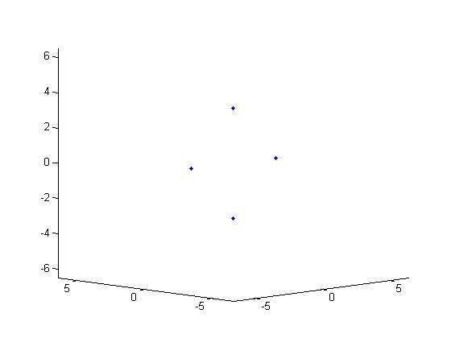

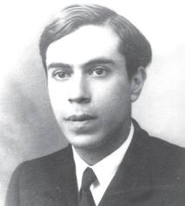
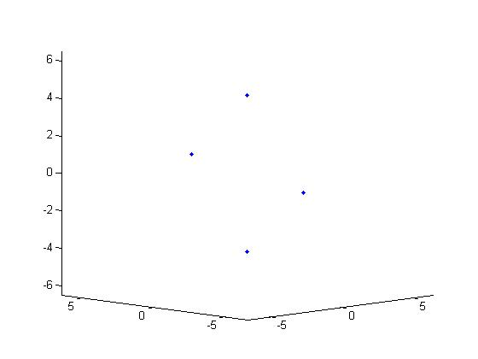
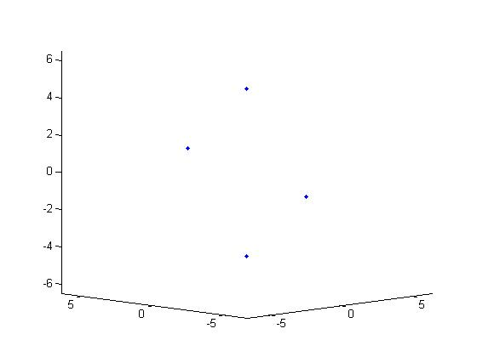
N = 1
k=2
k=3
k=4
k=5

Slide 72
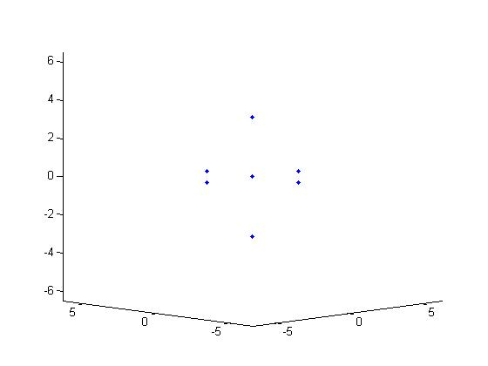
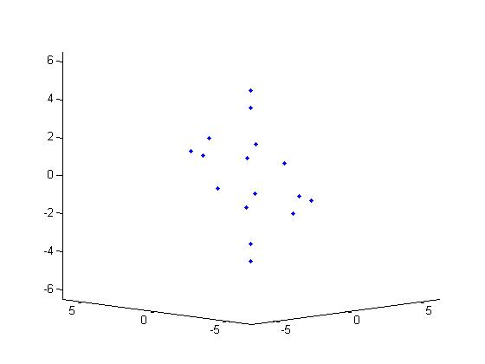
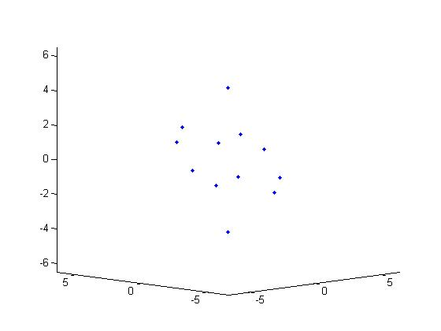
N = 2
k=2
k=3
k=4
k=5

Slide 73
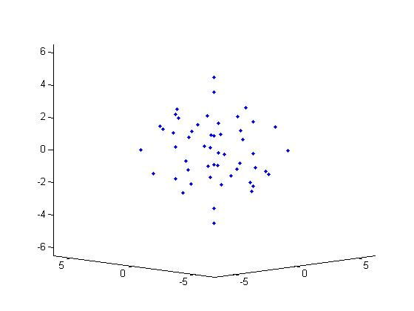
N = 3
k=2
k=3
k=4
k=5

Slide 74
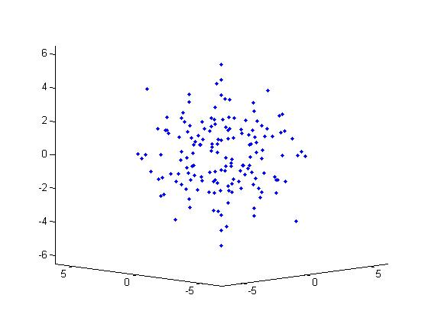
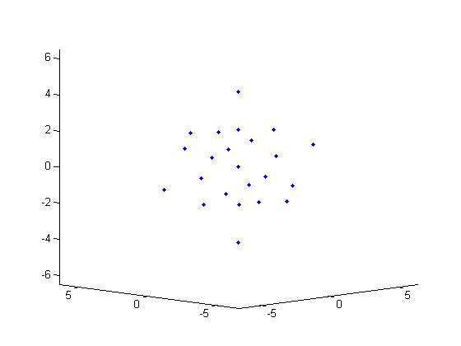
N = 4
k=2
k=3
k=4
k=5

Slide 75
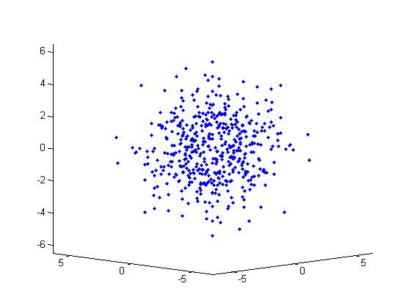
N = 5
k=2
k=3
k=4
k=5

Slide 76
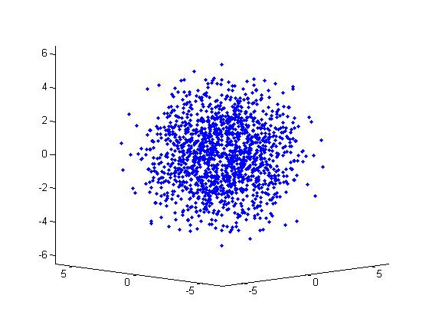
N = 6
k=2
k=3
k=4
k=5

Slide 77
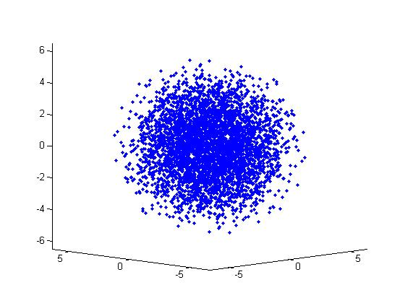
N = 7
k=2
k=3
k=4
k=5

Slide 78
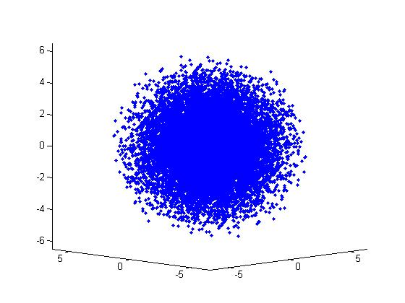
N = 8
k=2
k=3
k=4
k=5

Slide 79
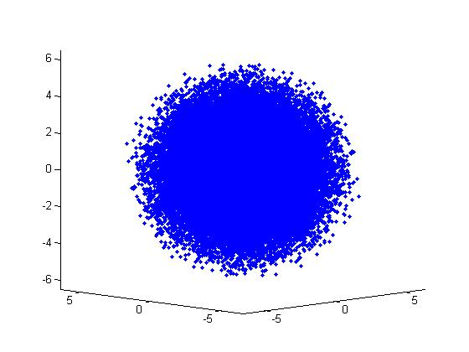
N = 9
k=2
k=3
k=4
k=5

Slide 80
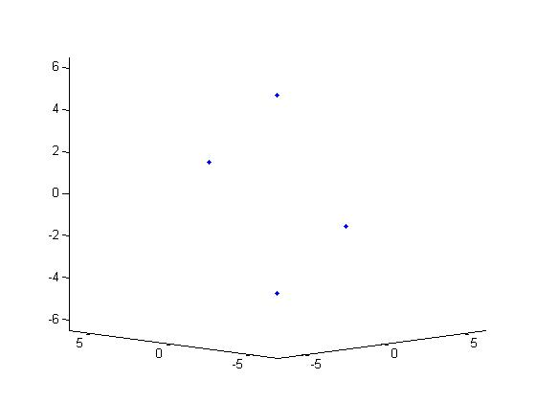
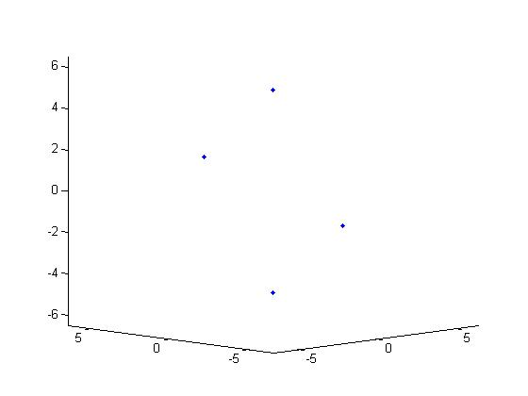
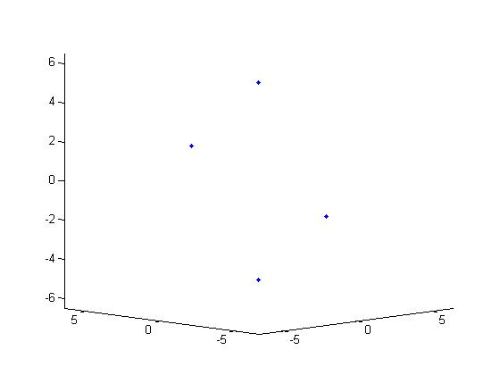
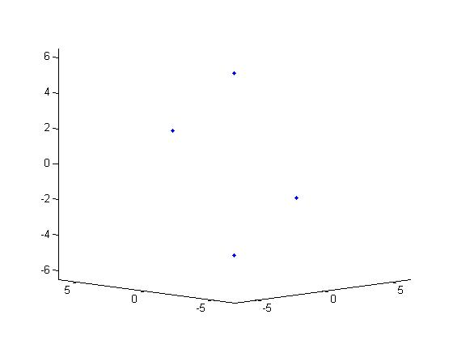
N = 1
k=6
k=7
k=8
k=9

Slide 81
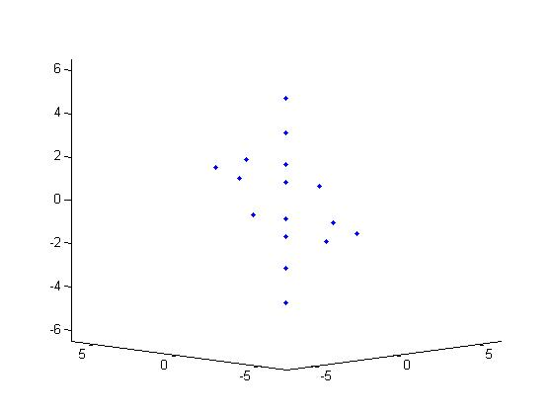
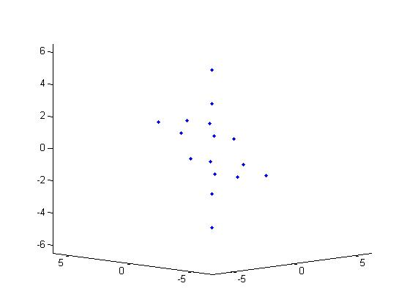


N = 2
k=6
k=7
k=8
k=9

Slide 82





N = 3
k=6
k=7
k=8
k=9

Slide 83




N = 4
k=6
k=7
k=8
k=9

Slide 84



N = 5
k=6
k=7
k=8
k=9

Slide 85



N = 6
k=6
k=7
k=8
k=9

Slide 86



N = 7
k=6
k=7
k=8
k=9

Slide 87



N = 8
k=6
k=7
k=8
k=9

Slide 88



N = 9
k=6
k=7
k=8
k=9

Slide 89
CNOT gate for SU(2)₅
X
L. Hormozi, NEB, & S.H. Simon, PRL 2009

Slide 90
“Surface Code” Approach
Key Idea: Use a quantum computer to simulate a theory of anyons.
The simulation “inherits” the fault-tolerance of the anyon theory.
Most promising approach is based on “Abelian anyons.” High error thresholds, but can’t compute purely by braiding.
Bravyi & Kitaev, 2003
Raussendorf & Harrington, PRL 2007
Fowler, Stephens, and Groszkowski, PRA 2009
More speculative idea: simulate Fibonacci anyons.
Konig, Kuperberg, Reichardt, Ann. Phys. 2010
NEB, D.P. DiVincenzo, PRB 2012

Slide 91
2D Array of Qubits

Slide 92
Trivalent Lattice

Slide 93
Trivalent Lattice

Slide 94
“Fibonacci” Levin-Wen Model
Levin & Wen, PRB 2005
Trivalent Lattice

Slide 95
“Fibonacci” Levin-Wen Model
Levin & Wen, PRB 2005
v
Trivalent Lattice
Vertex
Operator
Q_{v} = 0,1

Slide 96
“Fibonacci” Levin-Wen Model
Levin & Wen, PRB 2005
v
p
Trivalent Lattice
Vertex
Operator
Plaquette
Operator
Q_{v} = 0,1
B_{p} = 0,1

Slide 97
“Fibonacci” Levin-Wen Model
Levin & Wen, PRB 2005
v
p
Trivalent Lattice
Vertex
Operator
Plaquette
Operator
Q_{v} = 0,1
B_{p} = 0,1

Slide 98
“Fibonacci” Levin-Wen Model
Levin & Wen, PRB 2005
v
p
Trivalent Lattice
Ground State
Q_{v} = 1 on each vertex
B_{p} = 1 on each plaquette
Vertex
Operator
Plaquette
Operator
Q_{v} = 0,1
B_{p} = 0,1

Slide 99
“Fibonacci” Levin-Wen Model
Levin & Wen, PRB 2005
v
p
Trivalent Lattice
Ground State
Q_{v} = 1 on each vertex
B_{p} = 1 on each plaquette
Vertex
Operator
Plaquette
Operator
Excited States are Fibonacci
Anyons
Q_{v} = 0,1
B_{p} = 0,1

Slide 100
Vertex Operator: Q_{v}
“Fibonacci” Levin-Wen Model
j
j
i
v
i
v
k
k
All other

Slide 101
Vertex Operator: Q_{v}
on each vertex
“branching” loop states.
“Fibonacci” Levin-Wen Model
j
j
i
v
i
v
k
k
All other

Slide 102
Plaquette Operator: B_{p}
on each plaquette
superposition of loop states
b
b
a
i
j
c
a
i’
j’
c
n
p
k
n’
p
k’
f
m
l
d
f
m’
l’
d
e
e
Very Complicated 12-qubit Interaction!

Slide 103
Plaquette Operator: B_{p}
on each plaquette
superposition of loop states
b
b
a
i
j
c
a
i’
j’
c
n
p
k
n’
p
k’
f
m
l
d
f
m’
l’
d
e
e
Very Complicated 12-qubit Interaction!

Slide 104
Plaquette Operator: B_{p}
on each plaquette
superposition of loop states
b
b
a
i
j
c
a
i’
j’
c
n
p
k
n’
p
k’
f
m
l
d
f
m’
l’
d
e
e
Very Complicated 12-qubit Interaction!

Slide 105
Plaquette Operator: B_{p}
on each plaquette
superposition of loop states
b
b
a
i
j
c
a
i’
j’
c
n
p
k
n’
p
k’
f
m
l
d
f
m’
l’
d
e
e
Very Complicated 12-qubit Interaction!

Slide 106
“Surface Code” Approach
Konig, Kuperberg, Reichardt, Ann. Phys. 2010
Use quantum computer to repeatedly measure Q_{v} and B_{p}.
v
p
If Q_{v}=1 on each vertex and B_{p}=1 on each plaquette, good. If not, treat as an “error.”
How hard is it to measure Q_{v} and B_{p} with a quantum computer?

Slide 107
Quantum Circuit for Measuring Q_{v}
1
2
2
1
v
3
3
X
X
X
X
NEB, D.P. DiVincenzo, PRB 2012

Slide 108
Quantum Circuit for Measuring Q_{v}
1
2
2
1
v
3
3
X
X
X
X
Syndrome qubit
NEB, D.P. DiVincenzo, PRB 2012

Slide 109
Quantum Circuit for Measuring Q_{v}
1
2
2
1
v
3
3
X
X
X
X
Syndrome qubit
That was easy! What about B_{p}?
NEB, D.P. DiVincenzo, PRB 2012

Slide 110
6-sided Plaquette: B_{p} is a 12-qubit Operator

Slide 111
6-sided Plaquette: B_{p} is a 12-qubit Operator
Physical
qubits are
fixed in
space

Slide 112
6-sided Plaquette: B_{p} is a 12-qubit Operator
Trivalent lattice
is abstract
and can be
“redrawn”
Physical
qubits are
fixed in
space

Slide 113
6-sided Plaquette: B_{p} is a 12-qubit Operator
Trivalent lattice
is abstract
and can be
“redrawn”
Physical
qubits are
fixed in
space

Slide 114
6-sided Plaquette: B_{p} is a 12-qubit Operator
Trivalent lattice
is abstract
and can be
“redrawn”
Physical
qubits are
fixed in
space

Slide 115
6-sided Plaquette: B_{p} is a 12-qubit Operator
Trivalent lattice
is abstract
and can be
“redrawn”
Physical
qubits are
fixed in
space
6-sided plaquette becomes
5-sided plaquette!

Slide 116
The F–Move
Locally redraw the lattice five qubits at a time.

Slide 117
The F–Move
Apply a unitary operation on these five qubits to stay in the Levin-Wen ground state.
a
d
a
d
e
e’
b
c
b
c

Slide 118
F Quantum Circuit
a
d
a
d
e
e’
b
c
b
c
a
b
=
X
X
c
X
X
d
e
F
X
F
NEB, D.P. DiVincenzo, PRB 2012

Slide 119
F Quantum Circuit
1
5
4
1
5
4
a
1
2
3
2
3
b
2
3
c
4
d
5
e
a
d
a
d
e
e’
F
b
c
b
c
NEB, D.P. DiVincenzo, PRB 2012

Slide 120
Plaquette Reduction

Slide 121
Plaquette Reduction

Slide 122
Plaquette Reduction

Slide 123
Plaquette Reduction

Slide 124
Plaquette Reduction

Slide 125
Plaquette Reduction

Slide 126
Plaquette Reduction

Slide 127
Plaquette Reduction

Slide 128
Plaquette Reduction

Slide 129
Plaquette Reduction

Slide 130
Plaquette Reduction

Slide 131
Plaquette Reduction

Slide 132
Plaquette Reduction

Slide 133
Plaquette Reduction

Slide 134
Plaquette Reduction

Slide 135
Plaquette Reduction

Slide 136
Plaquette Reduction

Slide 137
Plaquette Reduction

Slide 138
Plaquette Reduction

Slide 139
Plaquette Reduction

Slide 140
Plaquette Reduction

Slide 141
Plaquette Reduction

Slide 142
Plaquette Reduction

Slide 143
Plaquette Reduction

Slide 144
Plaquette Reduction

Slide 145
Plaquette Reduction
2-qubit “Tadpole”

Slide 146
Measuring B_{p} for a Tadpole is Easy!
a
a
b
b
b
S
S
a
X
S Quantum Circuit
a
X
X
=
b
S
S

Slide 147
Plaquette Restoration

Slide 148
Plaquette Restoration

Slide 149
Plaquette Restoration

Slide 150
Plaquette Restoration

Slide 151
Plaquette Restoration

Slide 152
Plaquette Restoration

Slide 153
Plaquette Restoration

Slide 154
Plaquette Restoration

Slide 155
Plaquette Restoration

Slide 156
Plaquette Restoration

Slide 157
Plaquette Restoration

Slide 158
Plaquette Restoration

Slide 159
Quantum Circuit for Measuring B_{p}
1
b
b
2
b
b
3
b
b
2
4
b
b
5
b
b
1
8
9
3
6
c
c
7
e
c
c
e
7
p
10
a
e
c
c
e
a
8
12
11
9
a
e
c
c
e
a
6
4
a
e
c
c
e
a
10
5
11
a
e
a
a
e
a
12
d
d
d
d
a
b
b
a
d
d
d
d
F
F
F
F
F’
S
S
F’
F
F
F
F
X
NEB, D.P. DiVincenzo, PRB 2012

Slide 160
Gate Count
1
b
b
2
b
b
2
3
b
b
4
b
b
1
3
5
b
b
8
9
6
c
c
7
e
c
c
e
7
p
10
8
a
e
c
c
e
a
9
a
e
c
c
e
a
6
12
11
4
10
a
e
c
c
e
a
11
a
e
a
a
e
a
12
d
d
d
d
a
b
b
a
d
d
d
d
5
F
F
F
F
F’
S
S
F’
F
F
F
F
X
8 5-qubit Toffoli Gates
2 4-qubit Toffoli Gates
10 3-qubit Toffoli Gates
43 CNOT Gates
24 Single Qubit Gates
371 CNOT Gates
392 Single Qubit Rotations
NEB, D.P. DiVincenzo, PRB 2012

Slide 161
Plaquette Swapping
2
B_{p} = ?
1
9
3
8
7
10
6
12
11
4
5

Slide 162
Plaquette Swapping
2
B_{p} = ?
1
9
3
8
15
10
Freshly initialized
“tadpole” in LW ground state
7
14
12
6
13
11
4
5

Slide 163
Plaquette Swapping
B_{p} = ?
B_{p}=1

Slide 164
Plaquette Swapping
B_{p} = ?
B_{p}=1

Slide 165
Plaquette Swapping
B_{p} = ?
B_{p}=1

Slide 166
Plaquette Swapping
B_{p} = ?
B_{p}=1

Slide 167
Plaquette Swapping
B_{p} = ?
B_{p}=1

Slide 168
Plaquette Swapping
B_{p} = ?
B_{p}=1

Slide 169
Plaquette Swapping
B_{p} = ?
B_{p}=1

Slide 170
Plaquette Swapping
B_{p} = ?
B_{p}=1

Slide 171
Plaquette Swapping
B_{p} = ?
B_{p}=1

Slide 172
Plaquette Swapping
B_{p} = ?
B_{p}=1

Slide 173
Plaquette Swapping
B_{p} = ?
B_{p}=1

Slide 174
Plaquette Swapping
B_{p} = ?
B_{p}=1

Slide 175
Plaquette Swapping
B_{p} = ?
B_{p}=1

Slide 176
Plaquette Swapping
B_{p} = ?
B_{p}=1

Slide 177
Plaquette Swapping
B_{p} = ?
B_{p}=1

Slide 178
Plaquette Swapping
B_{p} = ?
B_{p}=1

Slide 179
Plaquette Swapping
B_{p} = ?
B_{p}=1

Slide 180
Plaquette Swapping
Measure B_{p}
B_{p}=1

Slide 181
Plaquette Swapping Circuit
1
a
2
a
3
a
4
a
5
a
6
a
7
b
b
8
b
d
9
b
d
10
b
d
11
b
d
12
b
b
d
X
c
e
e
e
e
e
e
e
a
a
e
d
c
s
a
c
c
c
c
c
c
a
b
b
F’
F
F
F
F
F
F
F’
S
S
X
= SWAP
W. Feng, NEB, D.P. DiVincenzo, Unpublished

Slide 182
After Swapping
Measure B_{p}
B_{p}=1

Slide 183
After Swapping
B_{p} =1
No Error
B_{p}=1

Slide 184
After Swapping
B_{p}=1
Simply Remove Swapped Plaquette

Slide 185
After Swapping
B_{p} =0
Error
B_{p}=1

Slide 186
After Swapping
B_{p} =0
Error
B_{p}=1
Move “Packaged” Error Using F-Moves

Slide 187
After Swapping
B_{p}=1
Move “Packaged” Error Using F-Moves

Slide 188
After Swapping
B_{p}=1
Move “Packaged” Error Using F-Moves

Slide 189
After Swapping
B_{p}=1
Move “Packaged” Error Using F-Moves

Slide 190
After Swapping
B_{p}=1
Move “Packaged” Error Using F-Moves

Slide 191
After Swapping
B_{p}=1
Move “Packaged” Error Using F-Moves

Slide 192
After Swapping
B_{p}=1
Move “Packaged” Error Using F-Moves

Slide 193
After Swapping
B_{p}=1
Move “Packaged” Error Using F-Moves

Slide 194
After Swapping
B_{p}=1
Move “Packaged” Error Using F-Moves

Slide 195
After Swapping
B_{p}=1
Move “Packaged” Error Using F-Moves

Slide 196
1
2
3
4
5
6
7

Slide 197
1
2
3
4
1
2
3
4
5
6
5
6
7
7

Slide 198
1
2
3
4
1
2
3
4
5
6
5
1
2
3
4
6
7
6
7
5
7

Slide 199
1
2
3
4
1
2
3
4
5
6
5
1
2
3
4
6
7
6
7
5
7
1
2
3
4
6
5
7

Slide 200
1
2
3
4
1
2
3
4
5
6
5
1
2
3
4
6
7
6
7
5
7
1
2
3
4
1
2
3
4
6
6
5
5
7
7

Slide 201
1
2
3
4
1
2
3
4
5
6
5
1
2
3
4
6
7
6
7
5
1
2
3
4
7
1
2
3
4
1
2
3
4
6
6
5
6
5
5
7
7
7

Slide 202
1
2
3
4
1
2
3
4
5
6
5
1
2
3
4
6
7
6
7
5
1
2
3
4
7
1
2
3
4
1
2
3
4
6
6
5
6
5
5
7
7
7

Slide 203
1
2
3
4
1
2
3
4
5
6
5
1
2
3
4
6
7
6
7
5
1
2
3
4
7
1
2
3
4
1
2
3
4
6
6
5
6
SWAP
5
5
7
7
7

Slide 204
Pentagon Equation as a Quantum Circuit
1
c
d
b
2
d
b
c
3
b
c
d
=
4
c
d
b
5
a
e
a
e
a
SWAP
6
e
a
e
a
e
7
d
b
c
F
F
F
F
F
NEB, D.P. DiVincenzo, PRB 2012

Slide 205
Pentagon Equation as a Quantum Circuit
1
c
d
b
2
d
b
c
3
b
c
d
=
4
c
d
b
5
a
e
a
e
a
SWAP
6
e
a
e
a
e
7
d
b
c
F
F
F
F
F
NEB, D.P. DiVincenzo, PRB 2012

Slide 206
Pentagon Equation as a Quantum Circuit
F
F
=
SWAP
F
F
F
Simplified Pentagon Circuit
NEB, D.P. DiVincenzo, PRB 2012

Slide 207
Creating Excited States: Fibonacci Anyons
Konig, Kuperberg, Reichardt, Ann. Phys. 2010

Slide 208
Vertex Errors = String Ends

Slide 209
String Ends = Fibonacci Anyons
Fibonacci anyons

Slide 210
Konig, Kuperberg, Reichardt, Ann. Phys. 2010

Slide 211
Konig, Kuperberg, Reichardt, Ann. Phys. 2010

Slide 213
1 F-moves

Slide 214
1 F-moves

Slide 215
4 F-moves

Slide 216
4 F-moves

Slide 217
8 F-moves

Slide 218
8 F-moves

Slide 219
8 F-moves

Slide 220
32 F-moves

Slide 221
48 F-moves

Slide 222
48 F-moves

Slide 223
51 F-moves

Slide 224
51 F-moves

Slide 225
56 F-moves

Slide 226
56 F-moves

Slide 227
56 F-moves

Slide 228
56 F-moves

Slide 229
Dehn Twist
Konig, Kuperberg, Reichardt, Ann. Phys. 2010
Braid

Slide 245

Some excellent reviews:
Non-Abelian Anyons and Topological Quantum Computation,
C. Nayak et al., Rev. Mod. Phys. 80, 1083 (2008). (arXiv:0707.1889v2)
Lectures on Topological Quantum Computation,
J. Preskill, Available online at: www.theory.caltech.edu/~preskill/ph219/topological.pdf
NEB, L. Hormozi, G. Zikos, S.H. Simon, Phys. Rev. Lett. 95 140503 (2005).
S.H. Simon, NEB, M.Freedman, N, Petrovic, L. Hormozi, Phys. Rev. Lett. 96, 070503 (2006).
L. Hormozi, G. Zikos, NEB, and S.H. Simon, Phys. Rev. B 75, 165310 (2007).
L. Hormozi, NEB, and S.H. Simon, Phys. Rev. Lett. 103, 160501 (2009).
M. Baraban, NEB, and S.H. Simon, Phys. Rev. A 81, 062317 (2010).
NEB and D.P. DiVincenzo, Phys. Rev. B 86, 165113 (2012).
Support: US DOE

